Slide 1
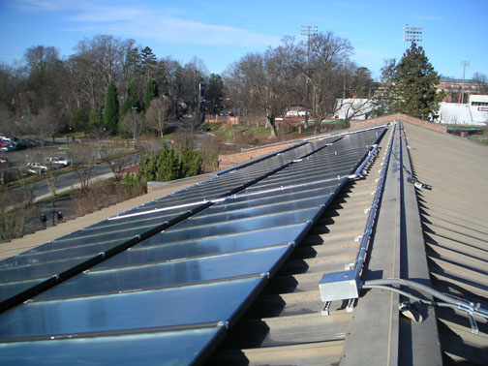
PV Solar within Campus Housing
Presented By:
Jeff Cook
Dr. Jorge Estevez
Kyle Zellner

Slide 2
Student Government Association
Student Senate represents the student body
3 resolutions in support of solar pv development on campus 2011-12
Environmental Sustainability Fund
$4 per student per year
Self sustained, with roll over
Environmental Affairs Committee
Mission Return to Eco-U roots

Slide 3
The Power of Coal
60% of WPS electricity derived from Coal
Pulliam Plant
16th Dirtiest Power Plant in the Nation
Pollutants
1,834,617 tons of CO₂
872,000 lbs of PM
140 lbs of Mercury

Slide 4
Climate Change and GHG emissions
IPCC 4th Assessment Report - 2007
Massachusetts v. EPA - 2007
EPA Actions
Mandatory GHG reporting
Endangerment Finding
GHG reductions in Cars
Proposed Power Plant Regulations

Slide 5
Climate Change effects on Wisconsin
Great Lake Levels drop 1-2 feet
Summer temps increase 8 degrees
Winter 6 degrees
2050 25 days of 90 degrees plus
Biodiversity shifts
Reduce tourism, hunting, fishing, silent sports

Slide 6
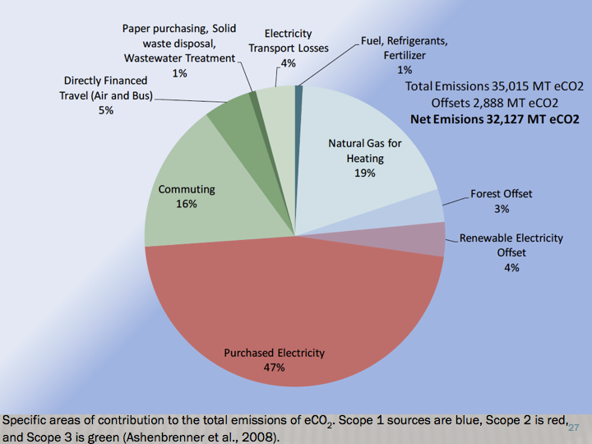
Eco-U and Climate Change
6.4 tons of carbon dioxide per student

Slide 7
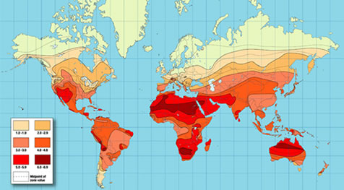
Solar Energy Potential

Slide 8
Solar Energy on Campus
Various site assessments conducted over 2011-12 conclude that a 6kW system is practical for campus
Roof Mounted System
LOW MAINTENANCE
LOW LIABILITY
MEASURABLE AND REPORTABLE DATA
Link
EFFICIENT
Commercial solar efficiency around 22%

Slide 9
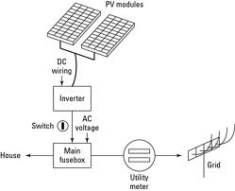
Aesthetics, Location, and weight
Wiring routed and contained connected with inverter and the grid
Any south facing roof
Weight less than 3 pounds per sq ft

Slide 10
Funding and End of Life Care
Campus Sustainability Committee and Student Government previously committed to a $30,000 project
Payback in 20 years through energy savings
This savings should be banked to pay for removal and replacement after 25-30 years of the operating life of the system
All components subject to vender 20 year warrantee

Slide 11
Summary
Reduce GHG emissions with Solar installation
Practice what we preach
Reportable data, utilities contained and conveniently placed, low maintenance, and educational
Funding provided by students and the chancellor’s office

Slide 12
Questions

